Slide 1


DSC 530 – Final Project
Ramsey King

Slide 2
Outline
Hypothesis – Do #1 seeds make the Final Four more often than other teams?
Variables used
Wins, Winning Percentage, Strength of Schedule, NCAA_Result, NCAA_Numeric, Year, Seed, RPI, RPI_Rank
Histogram of 5 variables
Wins, Winning Percentage, Strength of Schedule, RPI_Rank, Seed
Mean, Mode, Spread, Tails of Histogram Variables
PMF of which seeds remain in the Sweet 16 round and the Final Four round
CDF of Final Four Seedings
Pareto Distribution
Winning Percentage vs RPI and RPI vs Strength of Schedule scatter plots
Correlation Hypothesis Test
Regression Analysis

Slide 3
Hypothesis
#1 seeds make the Final Four more often than other seeds in the NCAA Men’s Basketball Tournament

Slide 4
Dataset explanation
Datasets used
Big_Dance_CSV
https://data.world/michaelaroy/ncaa-tournament-results/workspace/file?filename=Big_Dance_CSV.csv
The original purpose of the Big Dance CSV data set was to provide “every NCAA tournament game result since 1985 (when the tournament was expanded to the 64-team bracket). The dataset contains the year, round (1-6), seed of the teams (1-16), region (1-4) and the scores.”
Ncaa-team-data
https://data.world/mkearney/ncaa-mens-cbb-teams
The ncaa-team-data data set was obtained from the above link. The description of the data set is “I scraped data from sports-reference.com and made it tidy.”
RPIStats
https://www.collegerpi.com/subs/index.html
http://rpiarchive.ncaa.org/
The RPIStats dataset was obtained from multiple sources and combined into one. For the years 1994 through 2017, the data was obtained from College RPI. For the years 1985 through 1993, the data was obtained from the RPI Archive.
NCAA Institutions
https://en.wikipedia.org/wiki/List_of_NCAA_Division_I_institutions
The NCAA Institutions data set was obtained from Wikipedia. The data was collected and then put into a CSV file to be used for joining the other data sets together.

Slide 5
Variables Used
W (Wins)
WL (Winning %)
sos (Strength of schedule)
ncaa_result (How the team fared in the NCAA single elimination tournament)
ncaa_numeric (a numerical representation of ncaa_result)
Year
Seed
RPI

Slide 6
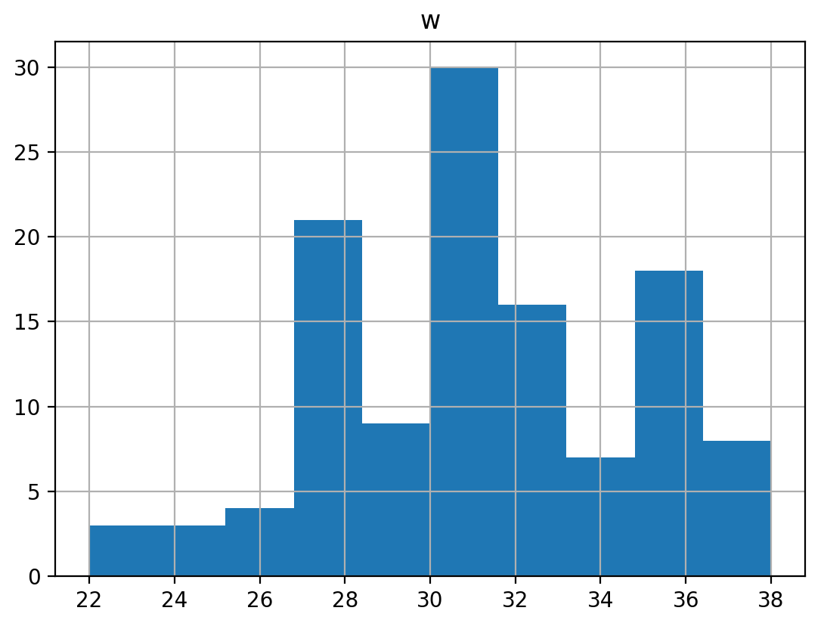
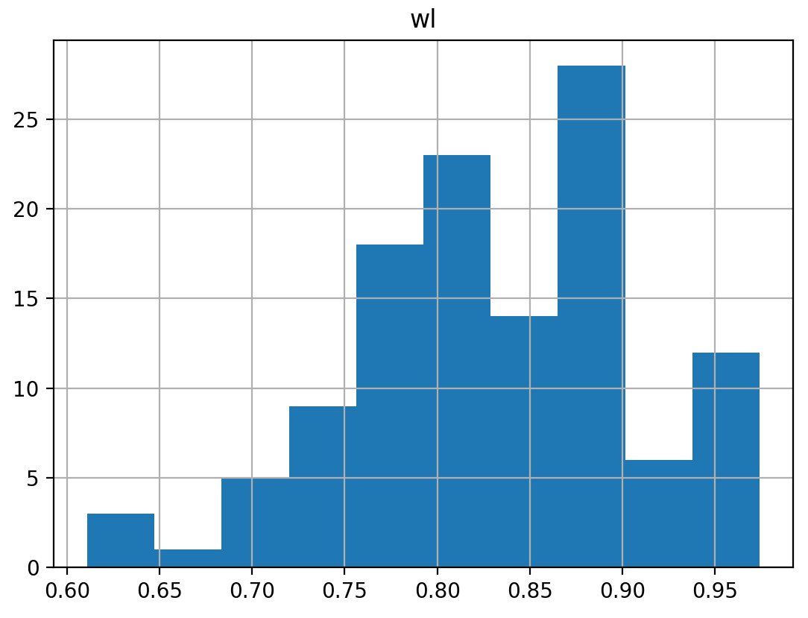
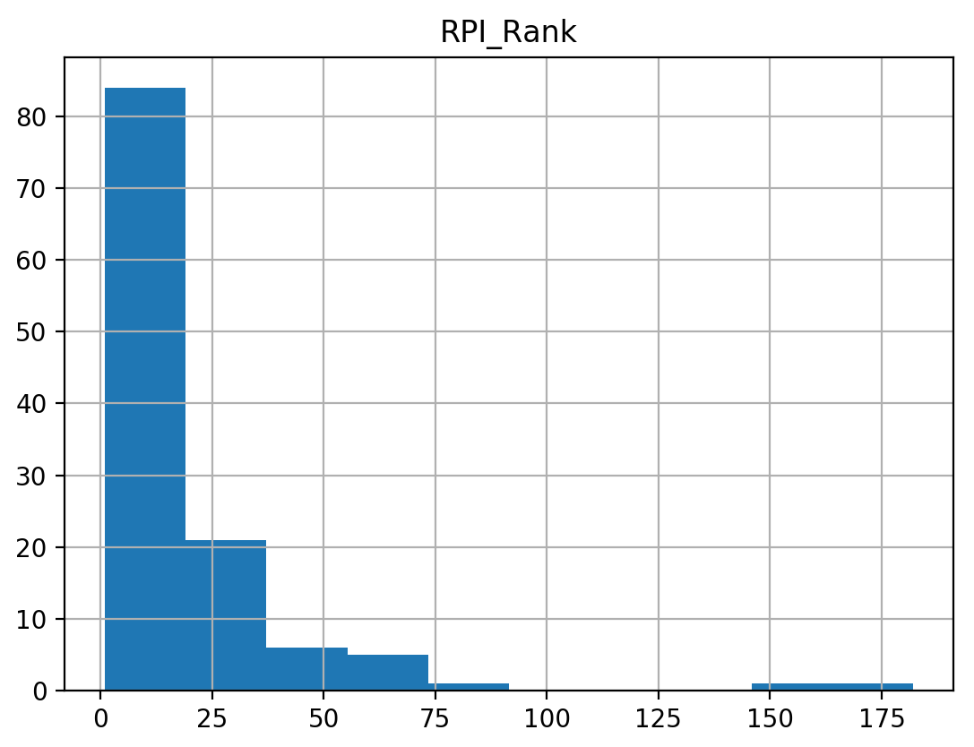
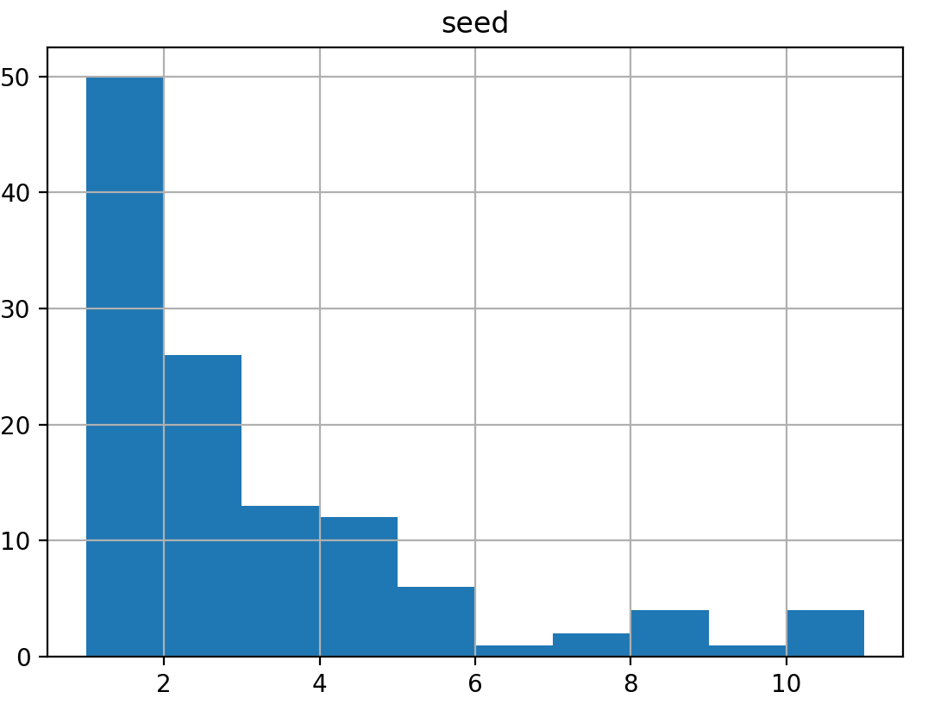
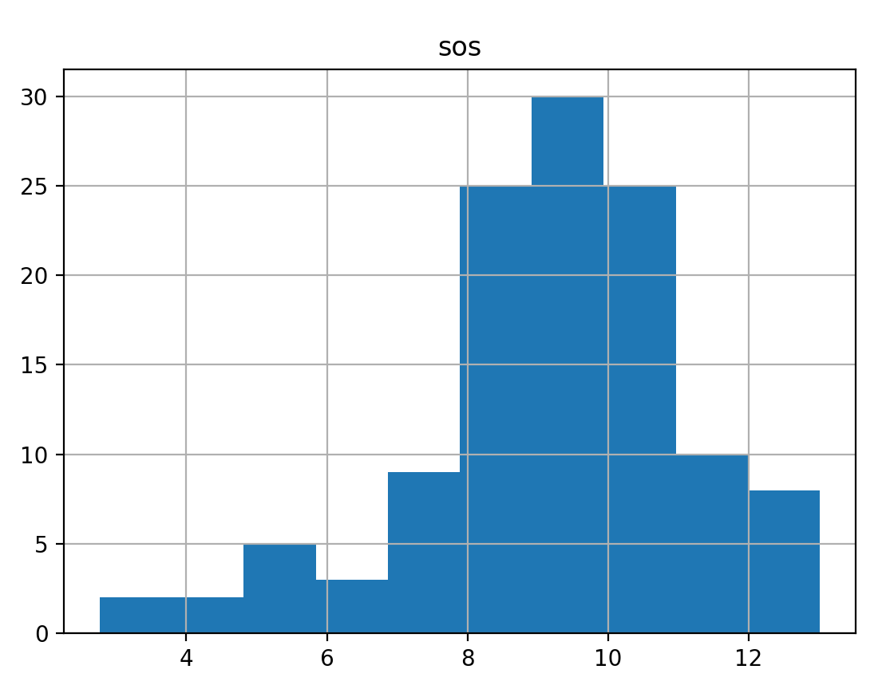
Histogram of Final Four Teams

Slide 7
Mean, Mode, Spread, Tails
 | Mean | Mode | Standard Deviation | Tails
Wins | 31.01 | 30 | 3.543 | -0.411
Winning Percentage | 0.831 | 0.897 | 0.077 | 0.100
RPI_Rank | 19.62 | 2 | 25.178 | 20.410
SOS | 9.20 | 6.09 | 1.943 | 1.127
Seed | 2.71 | 1 | 2.383 | 3.296

Slide 8
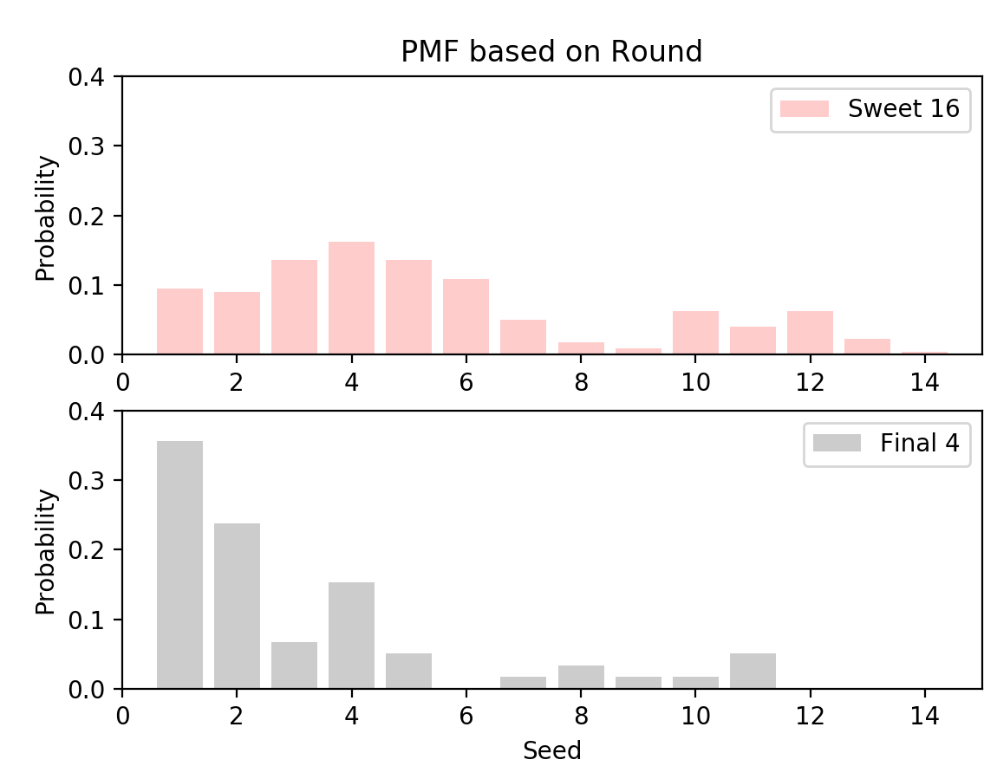
PMF Scenario Comparison
Seeds remaining based on rounds
These plots show that the further you go in the tournament, the lower the seeds become.

Slide 9
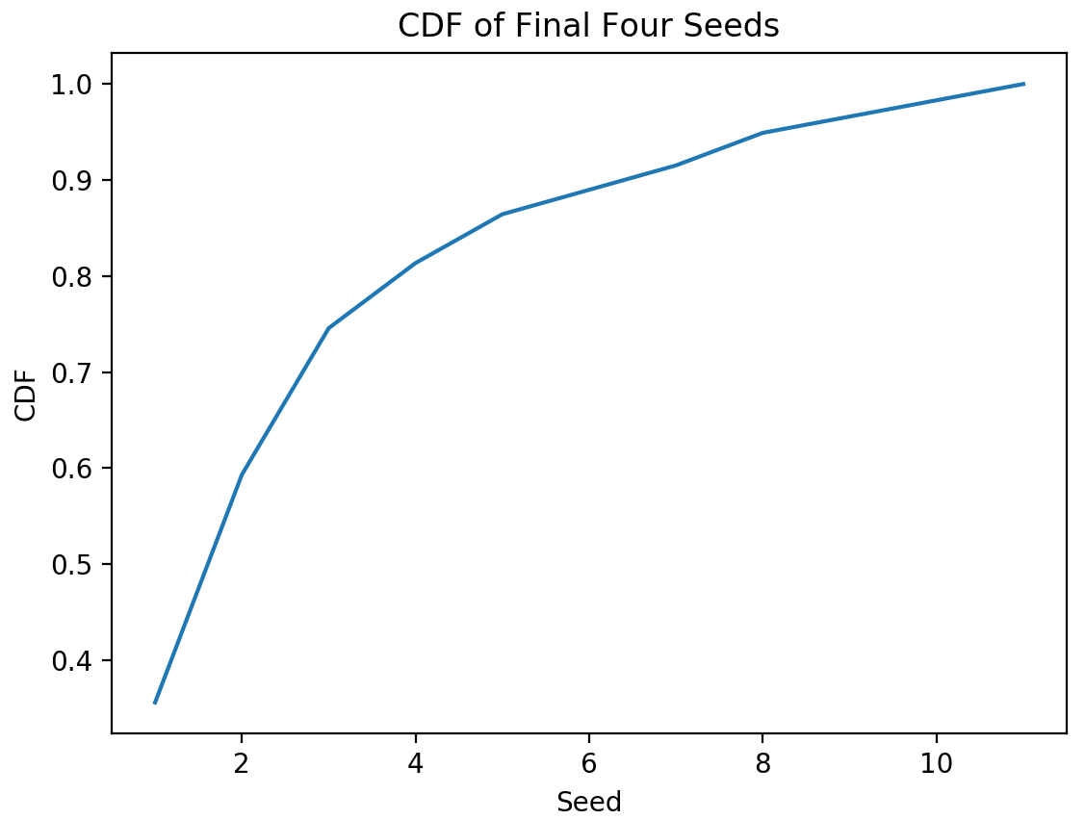
CDF of Final Four Seedings
This tells me that the overwhelming majority of Final Four Teams are #1 seeds.
It also shows that #2 seeds are often found in the Final Four

Slide 10
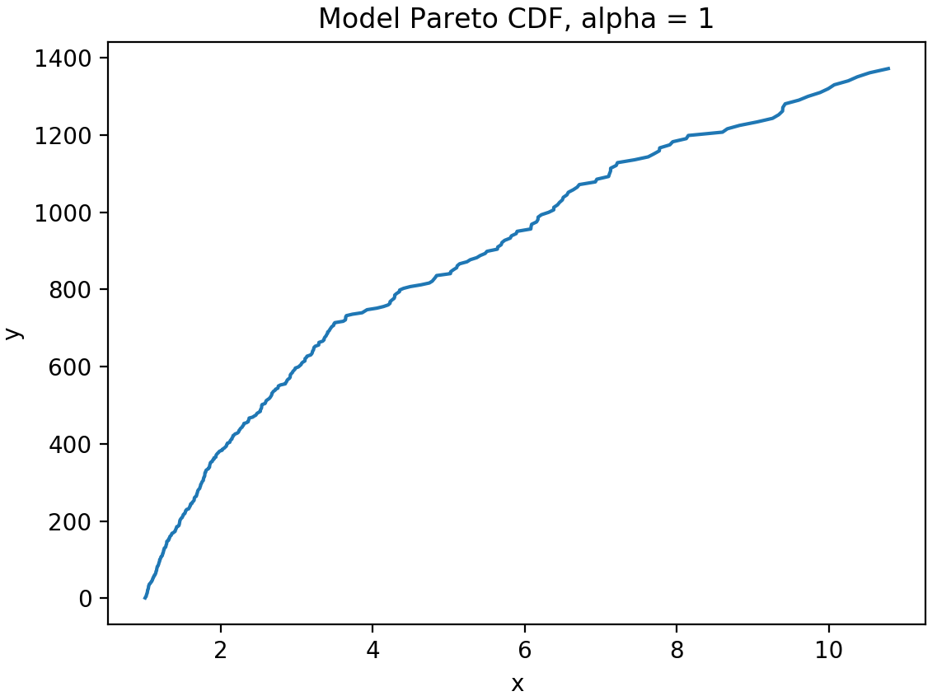
Analytical Distribution - Pareto
The analytical distribution that the data set most resembles is the Pareto distribution. The left-hand plot is a randomly created Pareto distribution, and the right-hand plot is our data set of Final Four teams and their seedings.

Slide 11
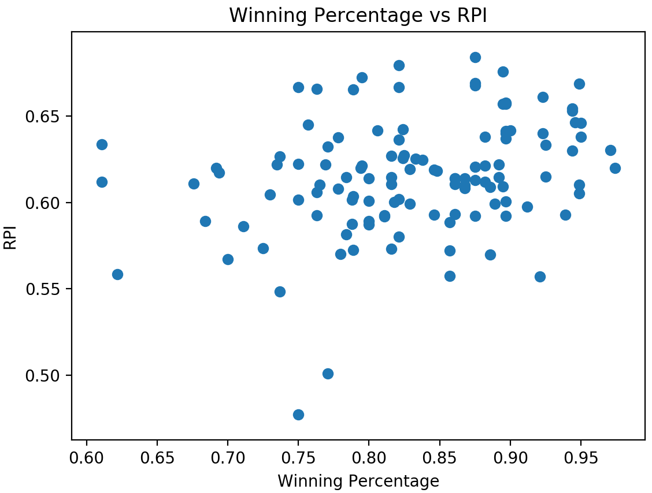
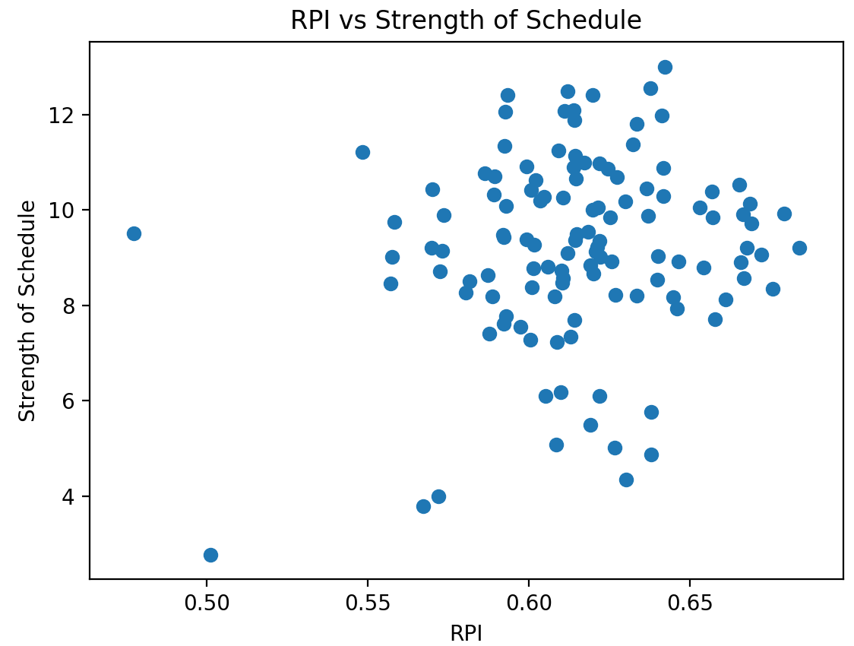
Scatter Plots (Winning Percentage vs RPI, RPI vs Strength of Schedule
Variables used: Winning Percentage vs RPI, and RPI vs Strength of Schedule
Winning Percentage and RPI correlation = 0.29; covariance = 0.0007
RPI and Strength of Schedule correlation = 0.14; covariance = 0.009

Slide 12
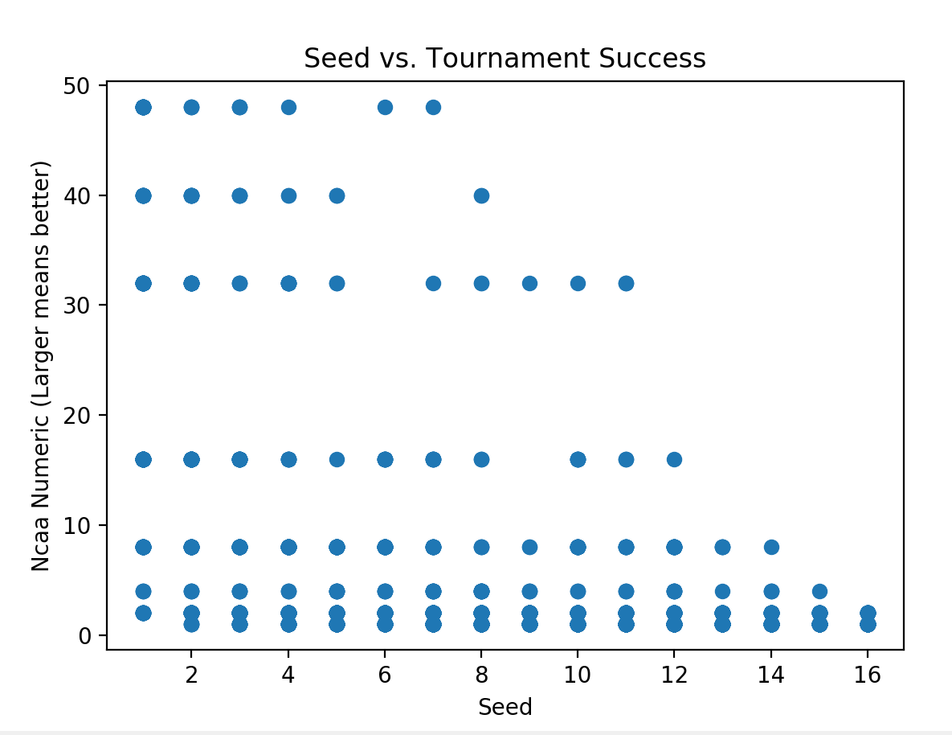
Correlation Testing of Seeding and Tournament Success
Using ‘seed’ as our x variable, and ‘ncaa_numeric’ as our y variable, Pearson R’s correlation calculates to -0.477 with a p-value of essentially 0 (1.33 x 10e-96)
When shuffling our seeds and running the simulated models over 1,000 iterations, the largest correlation value we receive is 0.079.
The observed correlation is statistically significant, meaning that success based on seeding is not random.
‘ncaa_numeric’
48 – Won national championship
40 – Lost national championship
32 – Final Four
16 – Elite 8
8 – Sweet 16
4 – Lost in Round of 32
1 & 2 -- Lost in Round of 64

Slide 13
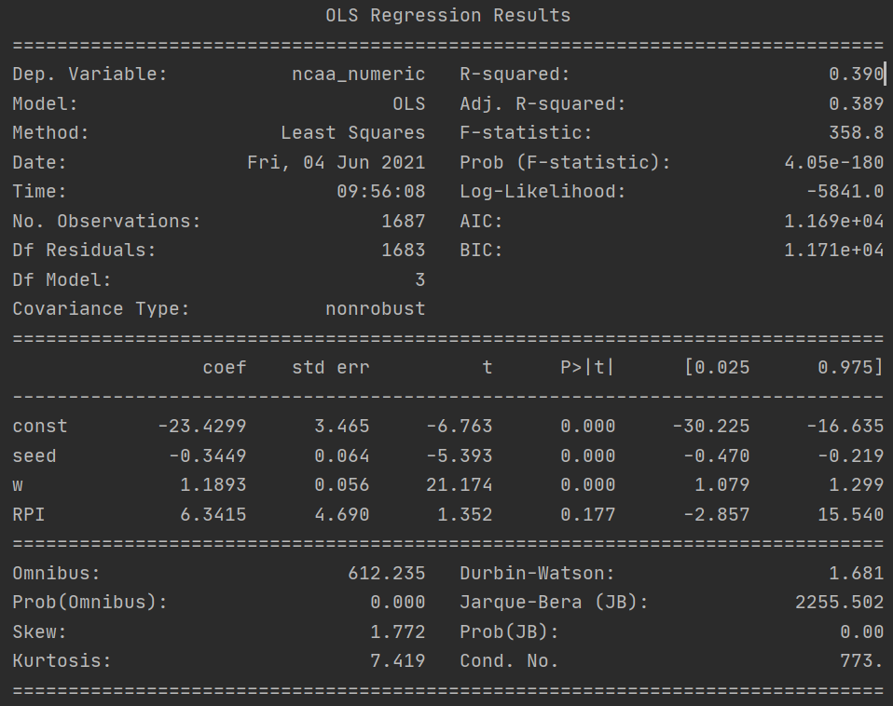
Regression Analysis
We used the following exploratory variables in our regression analysis to predict tournament success (ncaa_numeric):
Seed
Wins
RPI Rating
Statistical Findings:
R-squared = 0.39
P values of seed and wins = 0 (which means that these are statistically significant variables when determining tournament success)
Seed coefficient = -0.34, meaning that as the seed increases (from 1 to 16), the tournament success (ncaa_numeric) decreases

Slide 14
Summary
Hypothesis -- #1 seeds do make the Final Four more often than other seeds
Variables used
Wins, Winning Percentage, Strength of Schedule, NCAA_Result, NCAA_Numeric, Year, Seed, RPI, RPI_Rank
Histogram of 5 variables
Wins, Winning Percentage, Strength of Schedule, RPI_Rank, Seed
Outliers – there some higher seeds that reached the Final Four round
PMF of which seeds remain in the Sweet 16 round and the Final Four round
CDF of Final Four Seedings
Pareto Distribution
Final Four seedings follow a Pareto distribution, the top 4 seeds (25%) make up 80% of the Final Four teams remaining
Winning Percentage vs RPI and RPI vs Strength of Schedule scatter plots
Both variable pairs show a positive correlation to each other
Correlation Hypothesis Test
Seeding and how well a team does in the tournament is not random
Regression Analysis
A team’s success (ncaa_numeric) can be modeled by the number of wins they have, and what their seed is in a given year

